Slide 1


Clean Water Workshop
Notes:
Clean Water Workshop
Note to the presenter: If you are not comfortable presenting the entire PowerPoint slide or you want to give others a chance at presenting, consider splitting the presentation into two parts. e.g. Someone can present the first half covering EWB to the types of engineers, and the other presenter can present the workshop specific parts.
[Action] Start on this slide.
Welcome students, teachers and staff.
Introduce yourself, your co-presenter, and volunteers.
Time permitting, ask volunteers to state what they’re studying, for context.
State the name of the workshop

Slide 2



Acknowledgement of Country
We would like to acknowledge and pay our respects to the Traditional Owners of this country, and the custodianship of their elders past, present and into the future.
Notes:
[Action] Read off the slide.

Slide 3
Timeline
Appropriate technology
Activity of the Day!
What are engineers?
Pop quiz and questions
Who are EWB?
Notes:
Give them a run down of what the workshop will be like.
Don’t spend more than about 1-2 minutes on this slide.
Really important to run this slide so the kids have an idea of what they’re going to be doing for the workshop session! They will stay more engaged this way

Slide 4
Objectives
Work in a team to manage limitations and create a solution
Understand what appropriate technology and sustainable development is
Describe in your own words what it is to be an engineer
Have Fun!
Notes:
Skim over these learning outcomes, no need for an in-depth explanation

Slide 5
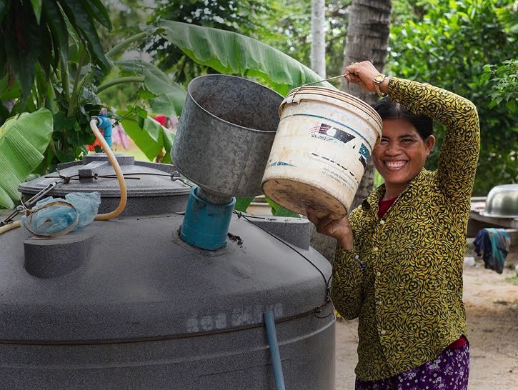
Who are Engineers without Borders (EWB)?
We connect, educate and empower people through humanitarian engineering
Notes:
Engineers Without Borders Australia (EWB) is a member-based, community organisation that creates social change through engineering
EWB works in partnership with developing communities in Australia and overseas, helping them to gain the knowledge, resources and appropriate technologies that they need to give them more control of their lives.
[Optional] Briefly mention Design Summits, overseas projects, and other experiences if appropriate.
Segue into the topic of engineering:
“So now that you’ve heard a bit about our organization, what about some of its members?”

Slide 6
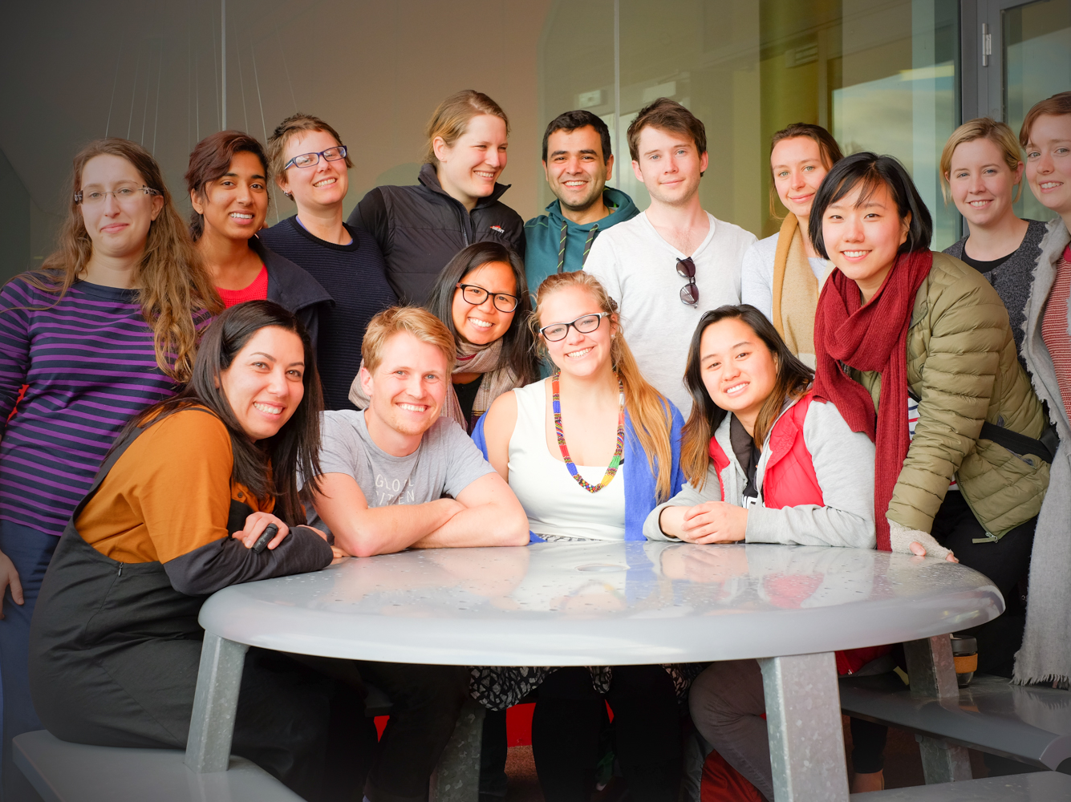
What are Engineers?
Notes:
“First of all, what exactly is an engineer? Does anyone have a relative or friend who is an engineer? “
[If any students put up their hands, then:] What does your [friend/relative] do at work? Try to give the audience an idea of what an engineer does
If the students are quiet, get the other volunteers to raise their hand and talk a bit about what they do

Slide 7
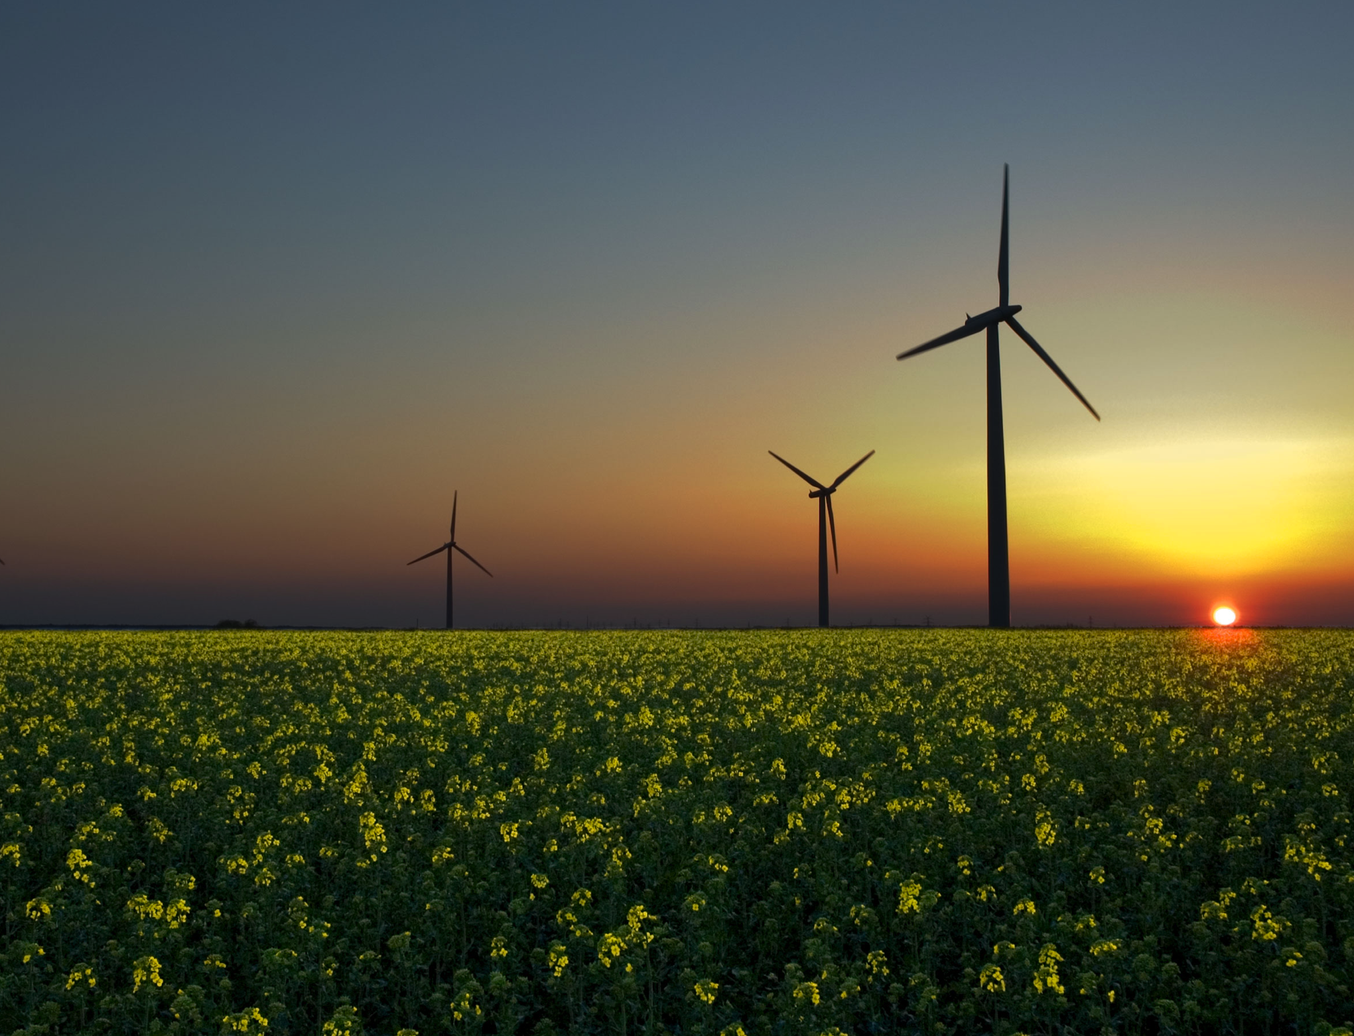
What are Engineers?
Engineers respond to needs of society by providing technological solutions to everyday problems in order to improve the quality of life
Notes:
[Action] Read off this slide.
Basically stating that engineers solve problems, giving examples like windmills, computers, and even basic items like the wheel or the light bulb.

Slide 8
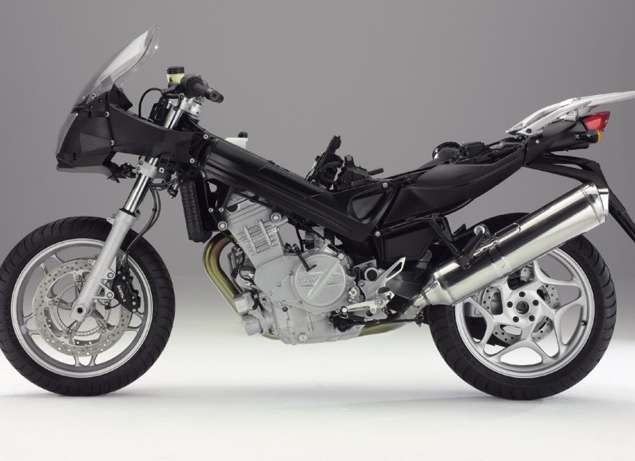
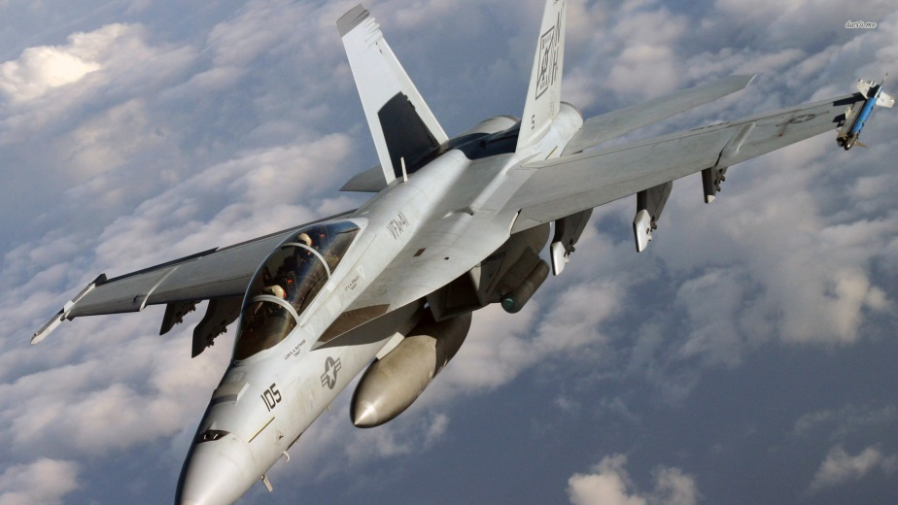
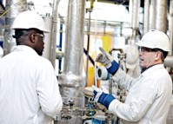


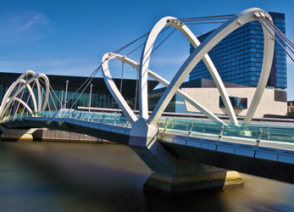
Types of Engineers
Mechanical
Aerospace
Chemical
Electrical
Mechatronic
Civil
Notes:
Each picture represents a different type of engineer. Get the students to guess the type and click on the picture to reveal the answer.
If you don’t have enough time, skim over each type quickly. Or else, feel free to talk more in-depth about each type (using below).
Mechanical engineers design and analyse moving systems found in things like cars and machines.
Aerospace engineers uses similar principles to look at how we can make machines that fly. Like planes and rockets!
Chemical engineers use a knowledge of chemistry and processes to make useful things like fuel, medicine and food, out of materials found in nature, like rocks and plants.
Electrical engineers work on everything from power supply to computers, phones and everything in between. Anything that involves electronic circuits usually has an electrical engineer behind it.
Mechatronics engineers combine skills from mechanical and electrical engineers to design robots.
Civil engineers design and build all the structures that we use today: like bridges, buildings and dams.

Slide 9
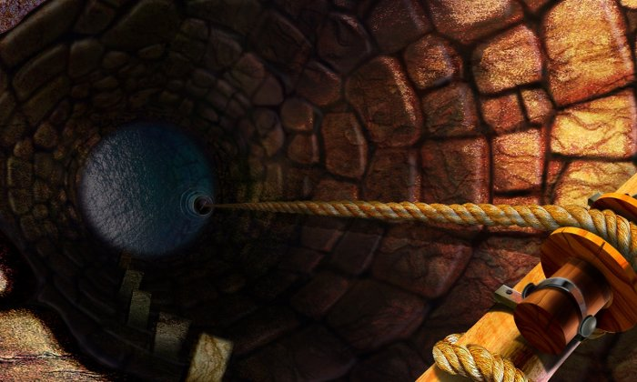
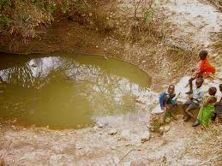
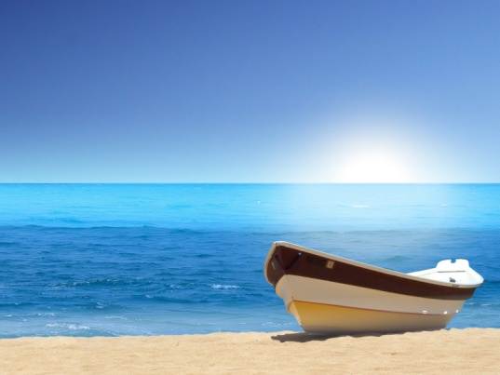
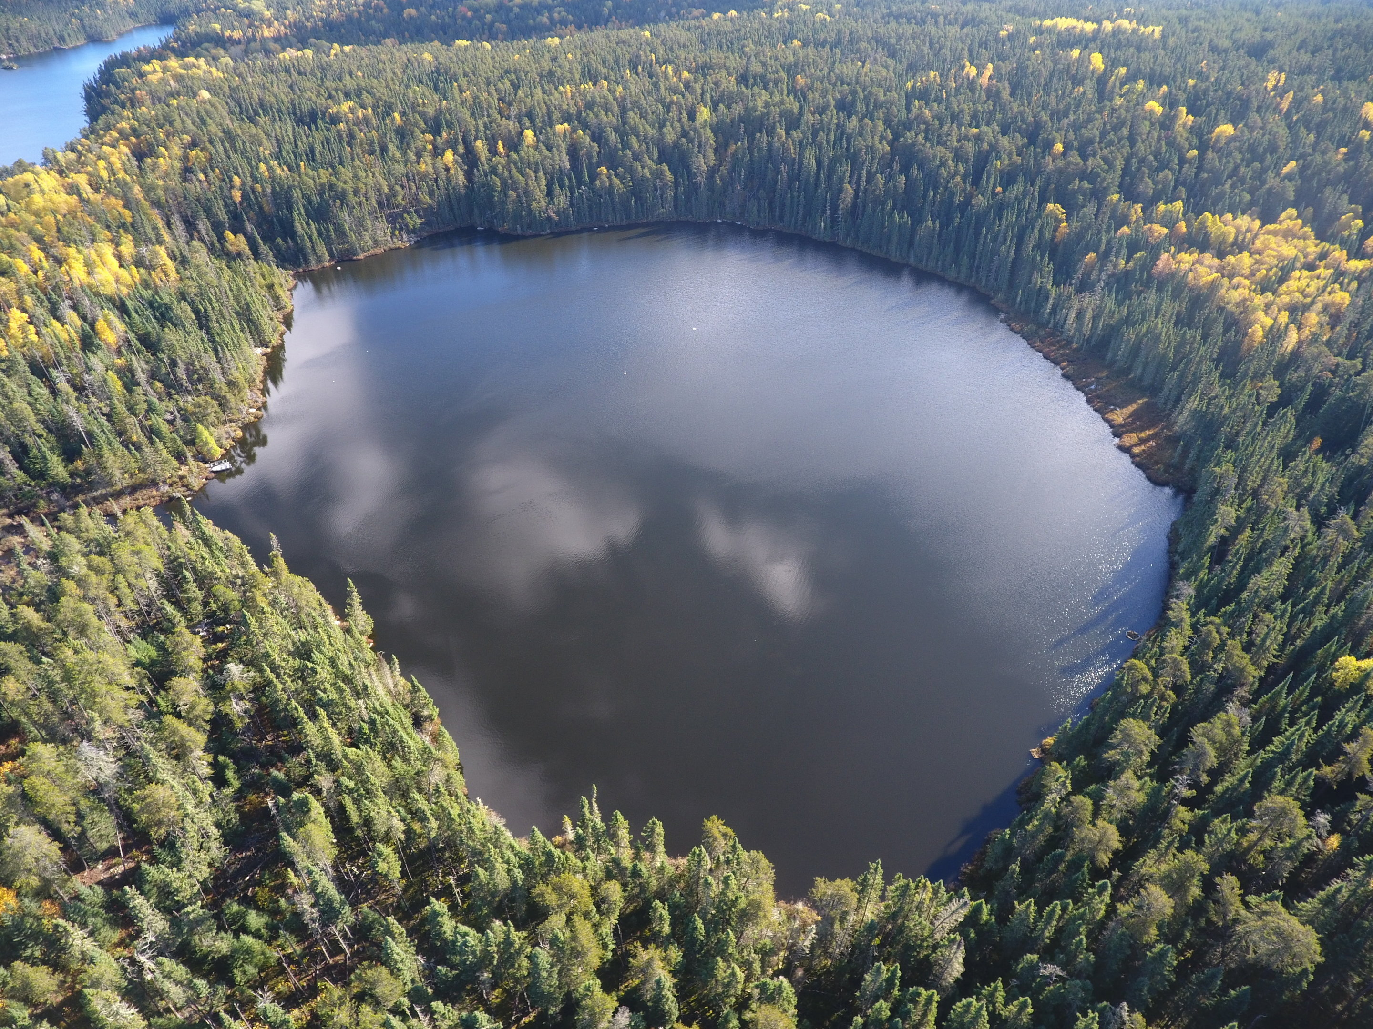
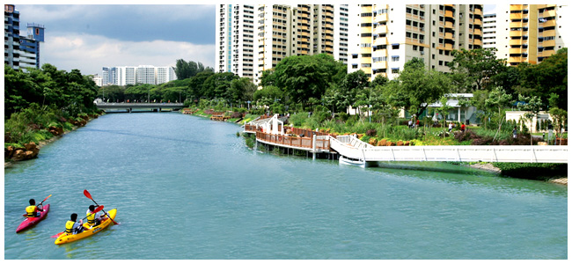
Where Does Water Come From?
Underground Water
Stillwater
Oceans
Lakes
Rivers
Notes:
Note: Presenter 2 usually takes over from here
Ask the audience: “Where do we get water from?”
[Animation] Clicking on image reveals the label
After all labels are revealed, ask the audience “Can we drink the water straight from these places? No… How do we get them clean and safe to drink?”

Slide 10
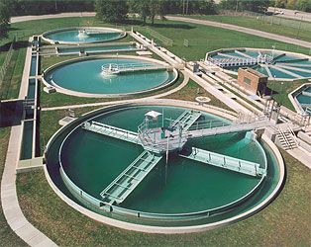
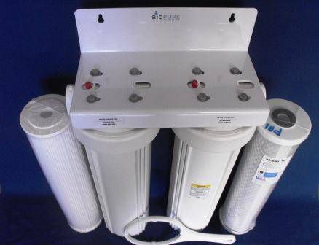
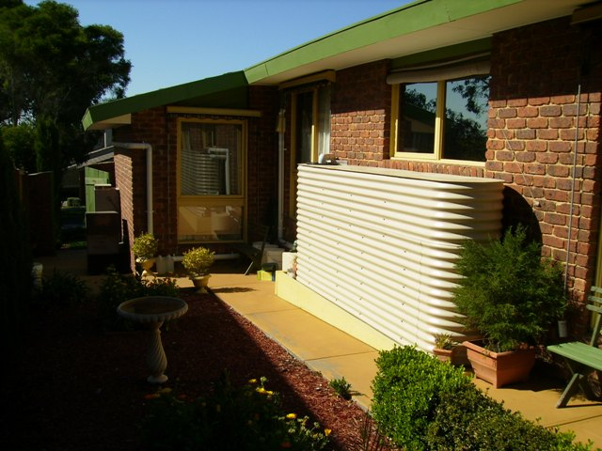
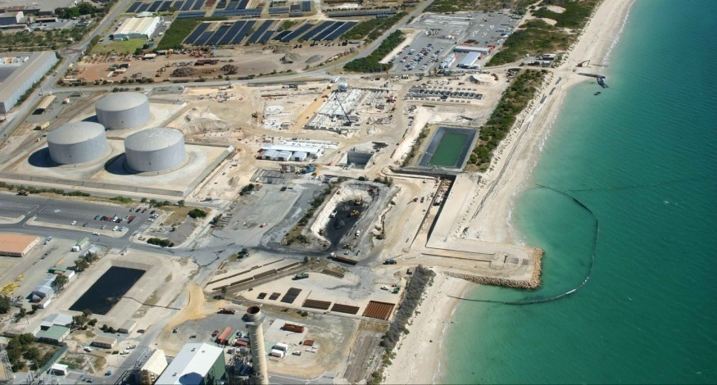
Water Filtration Methods
HOUSEHOLD WATER FILTER
RAINWATER TANK
Clarifiers
DESALINATION PLANT
Notes:
What sort of technologies are available to improve water quality?
Clarifiers – used in large scale water treatment plants to remove most of the solids using sedimentation
i.e. Using gravity to suspend solids
Household water filter – can be found under kitchen sink with multiple layers to remove most of the impurities turning into clean water
“Similar to what we are going to do today!”
Rainwater tank – used to collect rain water, treating it with adding Chlorine and using water filters or ultraviolet light treatment
Desalination plant – used to remove salt from seawater through the process of reverse-osmosis
Reverse-osmosis: “Forcing water through this membrane with tiny pores (think of it like a sponge with really, really small holes) so that water can pass through, but not the salt particles”
Are they applicable in developing countries? No….

Slide 11
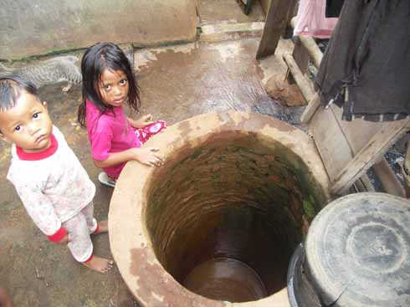
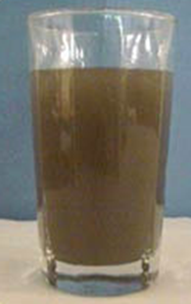
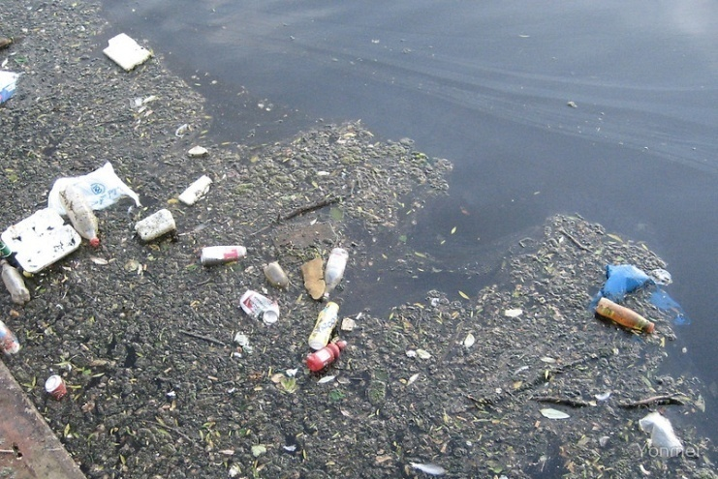
Access to Clean Water Around the World
As of 2019…
840 million people around the world lack access to clean water
1.8 billion people use a source of drinking water contaminated by faeces
740 million people survive on less than $1.90 a day
Notes:
Note: Breeze through this slide. This is just to give context
Read out the facts and contrast this to how clean and accessible water in Australia is
“So you can see how many people around the world are living in extreme poverty and don’t even have access to something so basic.”
“This picture was taken in Jakarta, Indonesia, with 20 million people living here, clean water is still a major concern here”

Slide 12
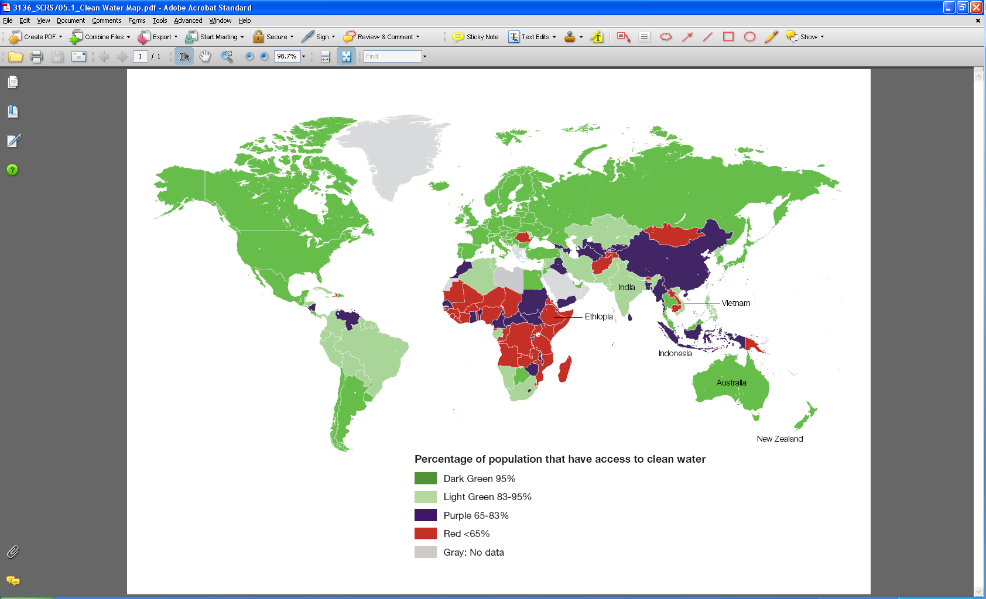
Access to Clean Water Around the World
Notes:
Compared to the rest of the world, Australians have it really good when it comes to clean water.
Show how more than 95% of Australians have access to clean drinking water, straight from our taps.
There are many countries, particularly in Africa and Asia (as shown in red/purple on the map), where significant portion of the population do not have access to clean drinking water.

Slide 13
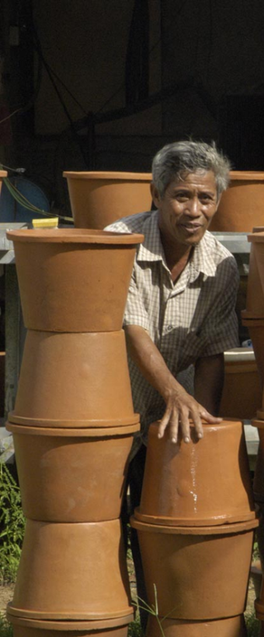
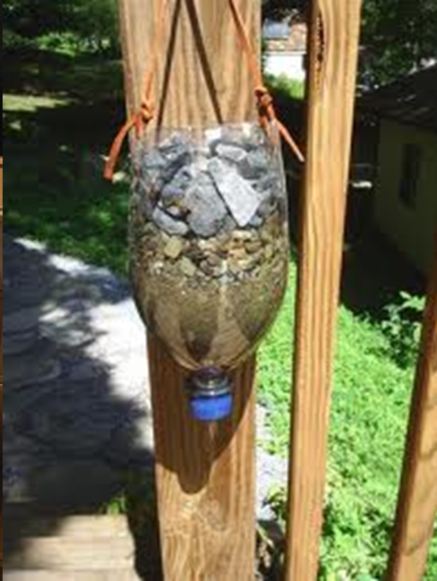
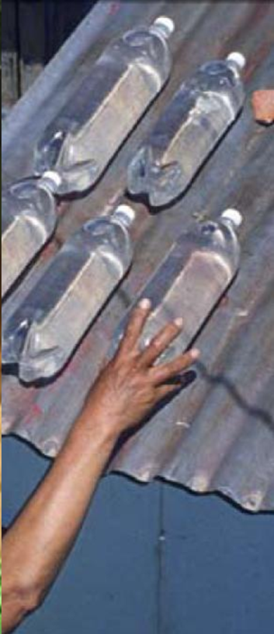
Alternative Water Filtration Methods
CERAMIC/CLAY POT FILTER
SOLAR WATER DISINFECTION
SAND FILTERS
Notes:
Explain the water filters
Left: Ceramic/clay pot filters. An inexpensive and effective type of water filter that rely on the small pores in the material to filter dirt and debris out of the water.
Middle: Sand filters. Using sand, gravel and recycled materials to separate the dirt in the water
Right: Solar water disinfection using plastic water bottles. Solar energy and UV radiation rid contaminated water of bacteria and viruses.

Slide 14
Factors to Consider
Cost
Physical
Environment
Available Materials & Electricity
Required Knowledge
Maintenance
People &
Culture
Notes:
[Animation] Clicking on the image will show the label
[Action] Ask the audience.
“What should we consider when planning and implementing any project in a developing country?”
Again, have volunteers on standby to offer information is the class is too quiet.

Slide 15
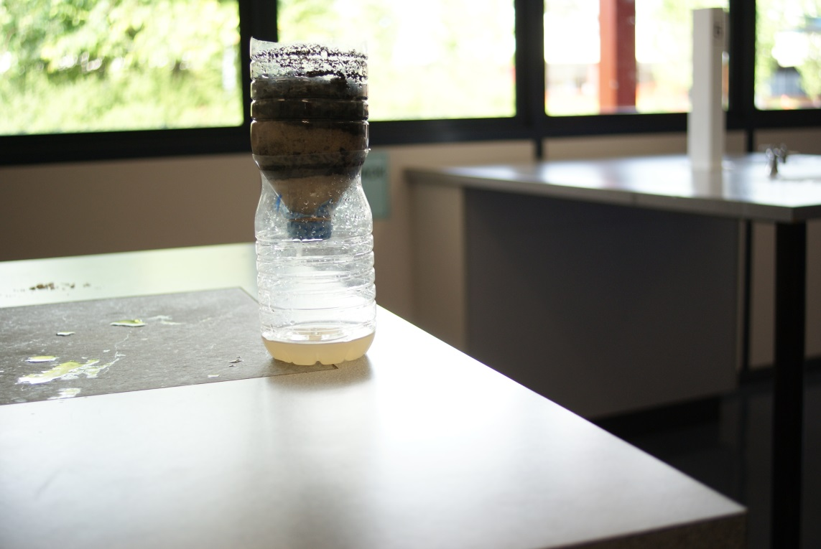
The Activity for Today!
Build a working water filter!
Notes:
Move onto the activity for the day

Slide 16
Instructions
Aim: Filter out the cleanest water!
Tasks | Minutes
1. Split into groups and go to a workstation | 2
2. Read information kit and plan your design | 10
3. Buy materials | 5
4. Build your water filter | 10
5. Test your water filter with dirty water | 5
Notes:
Students will get 20-30 minutes to complete the activity.
At least one volunteer will be required to operate the global shop
Roaming volunteers should be walking around to facilitate teamwork and discussion

Slide 17
Congratulations!
What worked well?
What didn’t work so well?
What can be improved?
Notes:
After packing everything, ask the students these questions.
This part is generally very open-ended, but try to relate the topics of teamwork, prior planning, etc.

Slide 18
The Real World
 | Real world
Different amount of money per group
Illegible instructions
Limited materials
Collaboration between countries
Inventive ideas
What we’ve done
Different countries have different national budgets
Based on actual country’s illiteracy rate
Access to materials can be dependent on geographical location
Foreign aid: AusAid, United Nations, World Vision, WHO etc.
The lack of information, funds, or resources can often encourage creative and effective ideas
Notes:
Prompt them with things like:
“Did all groups have the same amount of money?”
“So how do you think having different money in each group translates to the real world?”
- Money given were based on the country’s GDP.
“Could you all read the instructions?”
“What do you think having illegible instructions means when Australia’s instructions are really clear and Ethiopia cannot understand theirs at all?’
Illegibility of instructions were based on the country’s literacy rate
“Isn’t interesting to see that some of the poorer countries had reasonable results?”
“How did your group cope with limited money and instructions?”
- Inventive ideas
“Did any of the more developed countries help the others?”
- Emphasize that developed countries have a social responsibility to help those in developing countries.

Slide 19
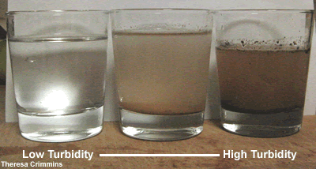
Turbidity
The cloudiness/haziness of a fluid visible to the naked eye
Caused by a large number of individual particles
Key test of water quality (less than 5 NTU for clean water)
Notes:
*Presenter 1*
Turbidity
The cloudiness or haziness of a fluid caused by a large number of individual particles that are generally invisible to the naked eye, similar to smoke in air. The measurement of turbidity is a key test of water quality.
NTU - nephelometric turbidity units
World Health Organisation (WHO) – International body, does research into all things health
WHO says <5 NTU is required for drinking water
Even in developed countries we can’t treat water with filtration agents like chlorine until it is below 5 NTU. Chemicals don’t react properly.
According to the Australian Drinking Water Guidelines, water should be less than 5 NTU.
Get the groups to estimate the turbidity of their clean water.
Give out prizes for the cleanest water

Slide 20
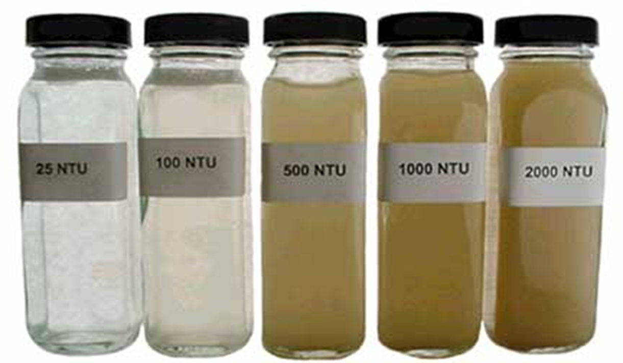
Turbidity
NTU- Nephelometric Turbidity Units
The lower the number, the clearer the water
Try to guess the turbidity of your water!
Notes:
*Presenter 1*
Turbidity
The cloudiness or haziness of a fluid caused by a large number of individual particles that are generally invisible to the naked eye, similar to smoke in air. The measurement of turbidity is a key test of water quality.
NTU - nephelometric turbidity units
World Health Organisation (WHO) – International body, does research into all things health
WHO says <5 NTU is required for drinking water
Even in developed countries we can’t treat water with filtration agents like chlorine until it is below 5 NTU. Chemicals don’t react properly.
According to the Australian Drinking Water Guidelines, water should be less than 5 NTU.
Get the groups to estimate the turbidity of their clean water.
Give out prizes for the cleanest water

Slide 21
Pop Quiz!
What is an engineer?
What are some factors that you need to consider when choosing an Appropriate Technology?
What challenges do developing countries face in the real world when creating water filters?

Slide 22
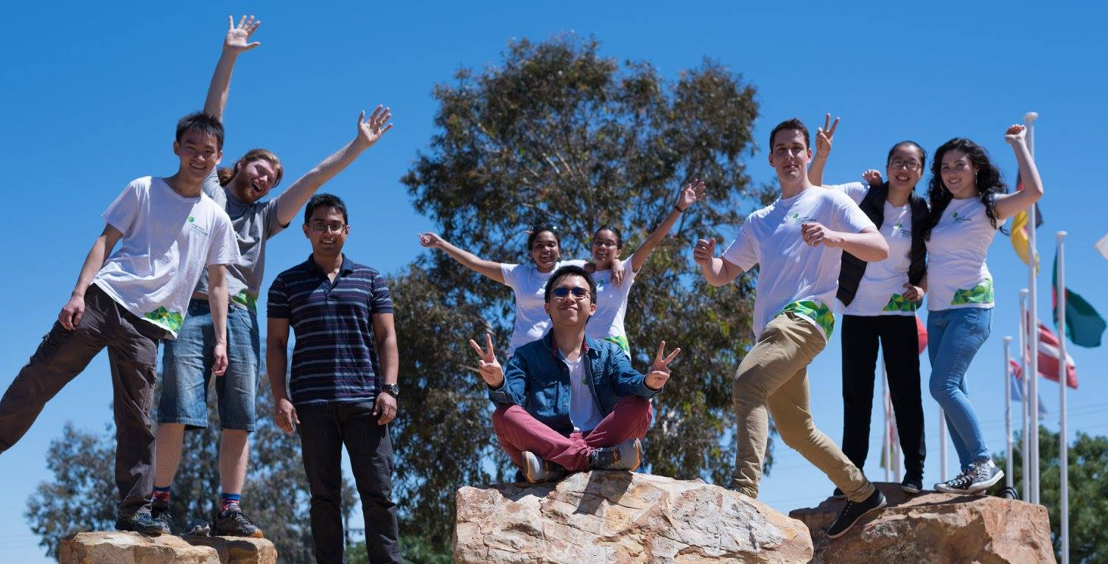
Like What You’ve Learned About Today?
Right now:
Stay informed. Think about what you want to fix in the world and how to do it
Spread the word about humanitarian engineering
Like us: facebook.com/ewbaustralia
Future:
Study at university or TAFE and volunteer
A job that makes a difference!

Slide 23
Questions?

